Slide 1


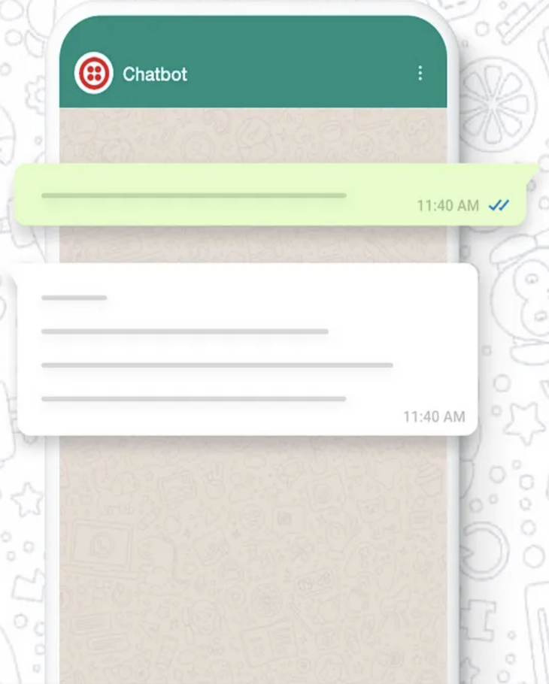






Integrated CHAT
GPT with
WhatsApp

Slide 2






request/response
OpenAI API key
Send Message
Receive Message
request/response
Twilio Phone Number: +14155238886
WhatsApp number: +XXXXXXXXXX
request
response
request/response
https://a94a-59-188-152-97.ngrok-free.app/sms
WhatsApp – CHAT GPT - Architecture

Slide 3

Integrated
Open Source Model
LLAMA3
using
AnyScale
with
WhatsApp

Slide 4

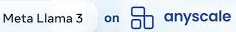
request/response
AnyScale API key
Send Message
Receive Message
request/response
Twilio Phone Number: +XXXXXXXXX
WhatsApp number: +XXXXXXXXXX
request
response
request/response
https://XXXXXXXXXXXXXXXXX.ngrok-free.app/sms
WhatsApp – LLAMA3 - Architecture

